Slide 1
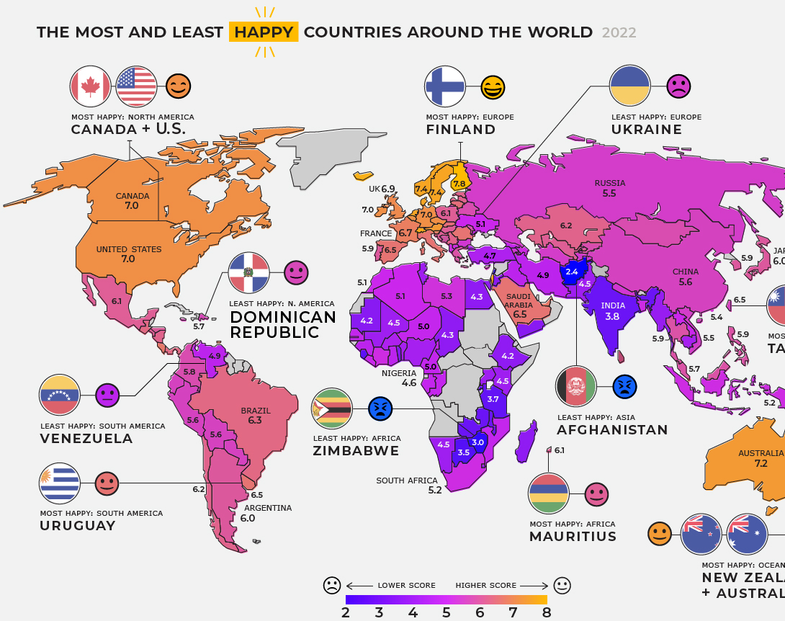
WORLD HAPPINESS CSE 351 Final Project
Iman Ali, Rahul Raja & Acero

Slide 2

Motivations
What are the factors that contribute to people's happiness?
Which countries have the highest happiness scores and why?
Which countries had stable rankings and which had increasing?
How does GDP, Freedom, Social support etc affect happiness scores
What are the general trends of happiness over the years? Increasing or decreasing
This project allows us to gain insight into the state of happiness in the world today.

Slide 3

Data Source & Authenticity https://worldhappiness.report
We used data from the World Happiness Report for different countries from year 2015 to year 2019.
The World Happiness Report is a landmark survey of the state of global happiness that ranks countries by how happy their citizens perceive themselves to be.
The report gains global recognition as governments, organizations and civil society increasingly use happiness indicators to inform their policy-making decisions.

Slide 4

Our Process
Merging & Cleaning
EDA
Modeling
This Photo by Unknown author is licensed under CC BY.

Slide 5

Data Merging and Cleaning

Slide 6
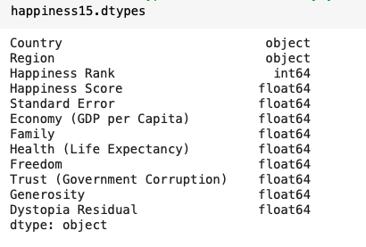
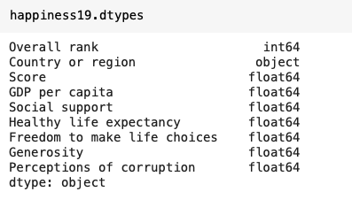
Data Merging Before merging, we need to make sure all data from years 2015-2019 is uniform with each other.
After some data exploration, we realize that column names are not consistent.
Iman Ali

Slide 7
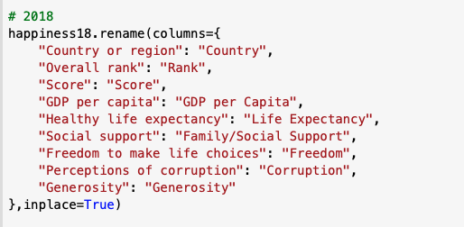
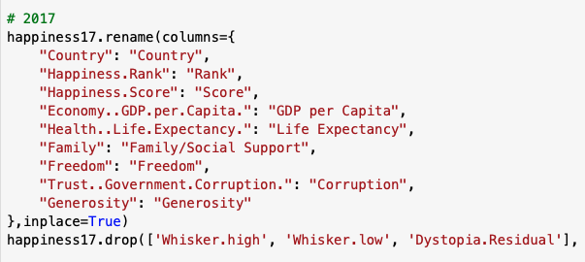
Reformatting Data
Since different years have different number and names of columns, we make them compatible by :
Filtering only the useful features/attributes for our analysis
Renaming all data-frame columns to same format
Country - Rank - Score - GDP per Capita - Life Expectancy - Family/Social Support - Freedom - Corruption - Generosity
Iman Ali

Slide 8
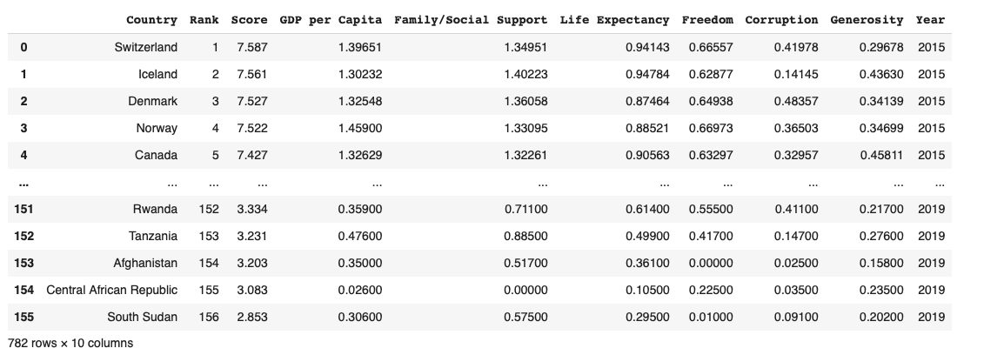
Merging Data
Add a 'Year' column to each set so this information is available once all data is combined together.
Iman Ali

Slide 9

Cleaning Data
Check for duplicates in data
Check for missing/null values
Only 1 value of corruption NaN, therefore performed Mean Imputation.
Replaced with mean value of corruption in United Arab Emirates in other years
Dropped data columns not available in every year such as region, confidence intervals, dystopia residual etc.
Iman Ali

Slide 10

Exploratory Data Analysis
This Photo by Unknown author is licensed under CC BY-NC-ND.

Slide 11
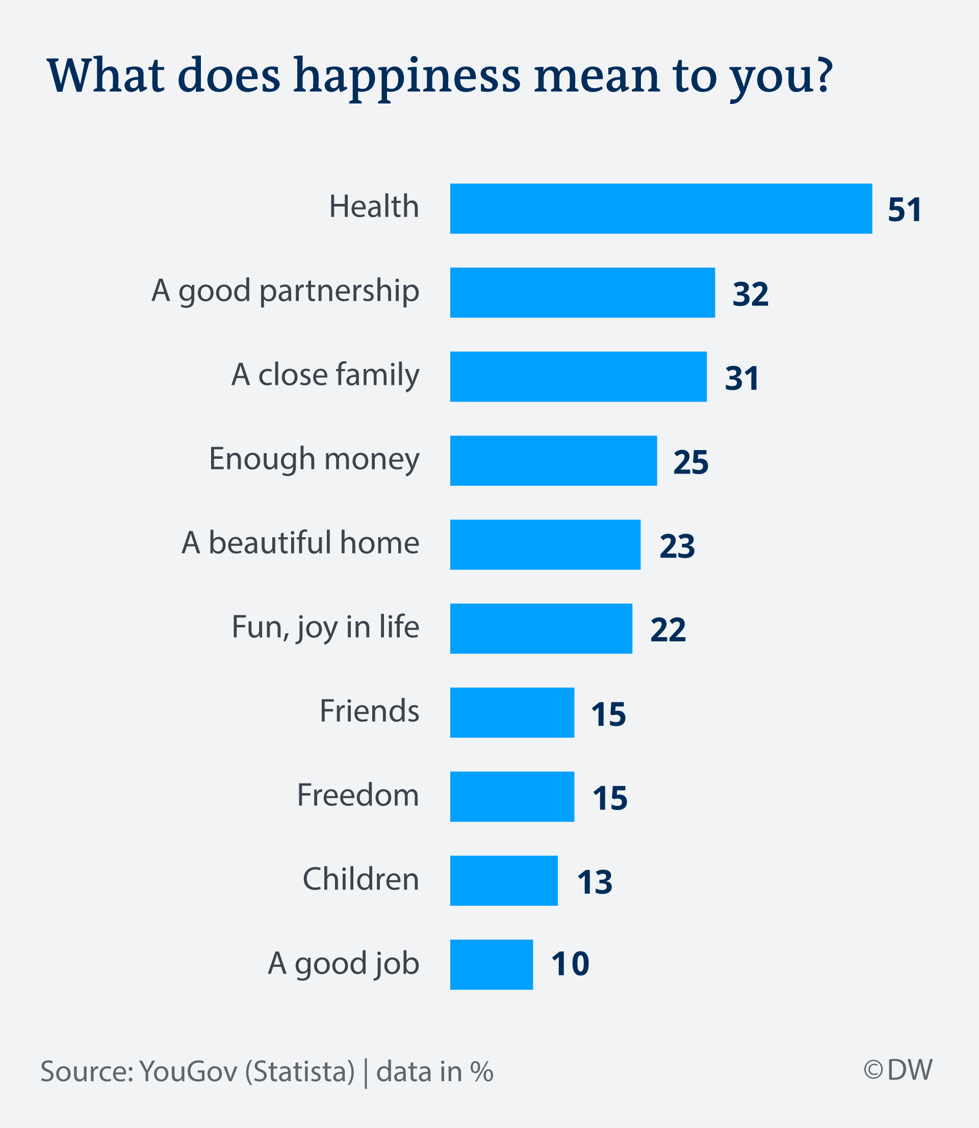
EDA
What are the central tendencies of happiness score over the years? Did they increase or decrease?
Which countries have stable rankings over the years? Which countries improved their rankings?
Visualize the relationship between happiness score and other features such as GDP, social support, freedom, etc.
Find out what features contribute to happiness. If you are the president of a country, what would you do to make citizens happier?
Iman Ali

Slide 12
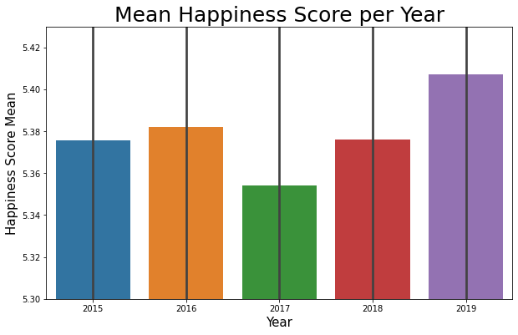
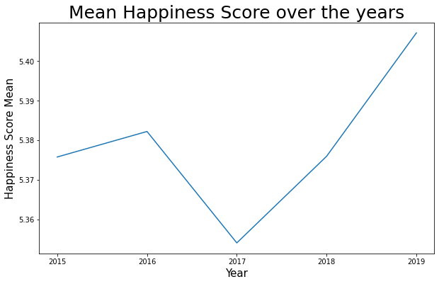
Central Tendencies of happiness score over the years?
Mean Analysis
Iman Ali

Slide 13
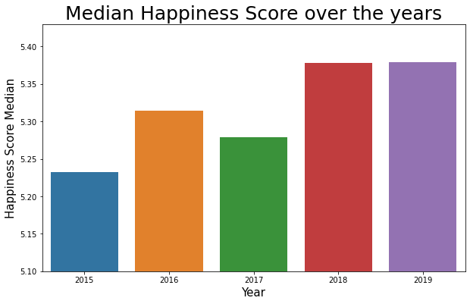
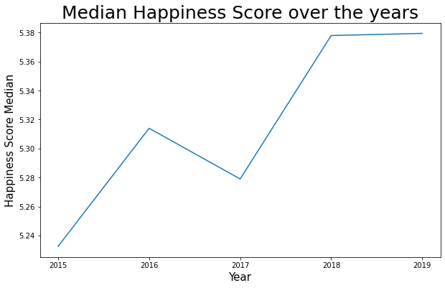
Central Tendencies of happiness score over the years?
Median Analysis
Iman Ali

Slide 14
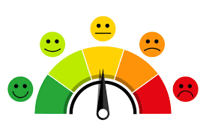
Central Tendencies of happiness Did they increase or decrease?
Both the Mean & Median seems to increase each year by a very small amount. The only exception is from 2016 to 2017 when the mean happiness score drops a bit, but then continues increasing again.
There is a general trend of increase!
Iman Ali

Slide 15
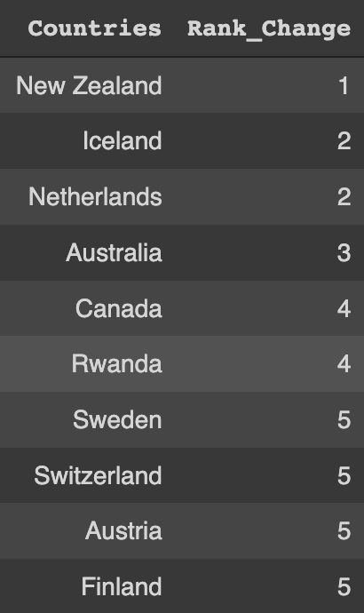
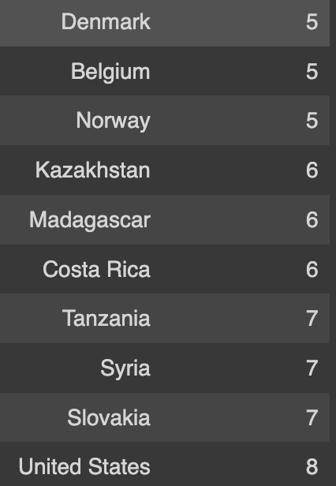
Analyze Country Ranks Stable ranks
Stable Ranks was analyzed by calculating the overall rank change within consecutive years between 2015 – 2019.
Below are listed the top 20 based on stability
Rahul Raja

Slide 16
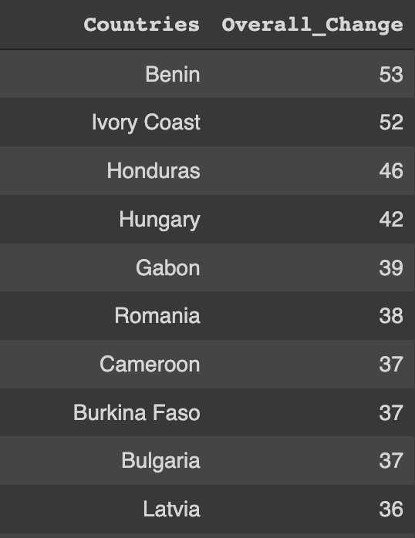
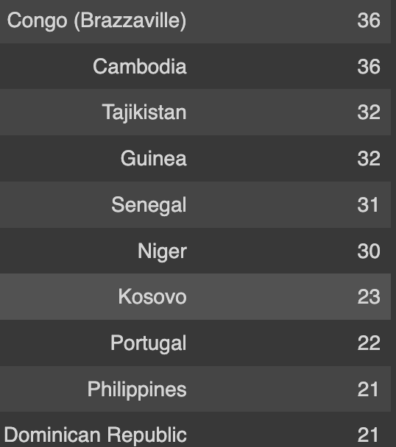
Analyze Country Ranks Improving ranks
This was calculated by using the initial rank from 2015 and the overall change from the final rank in 2019
Top 20 countries that improved the most in the happiness scale based on rank
Rahul Raja

Slide 17

Relationship between happiness score and other features

Slide 18
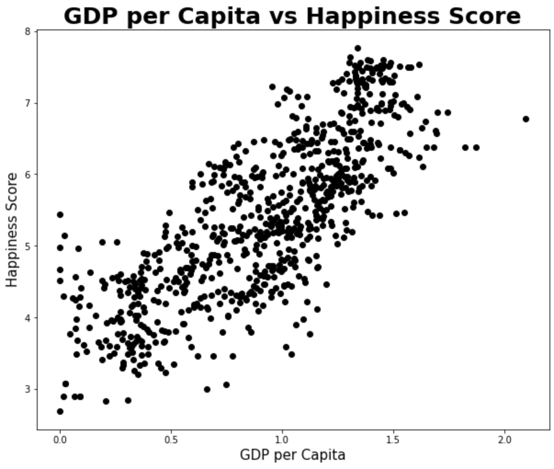
GDP vs Happiness Score
Correlation
Coefficient: 0.789

Slide 19
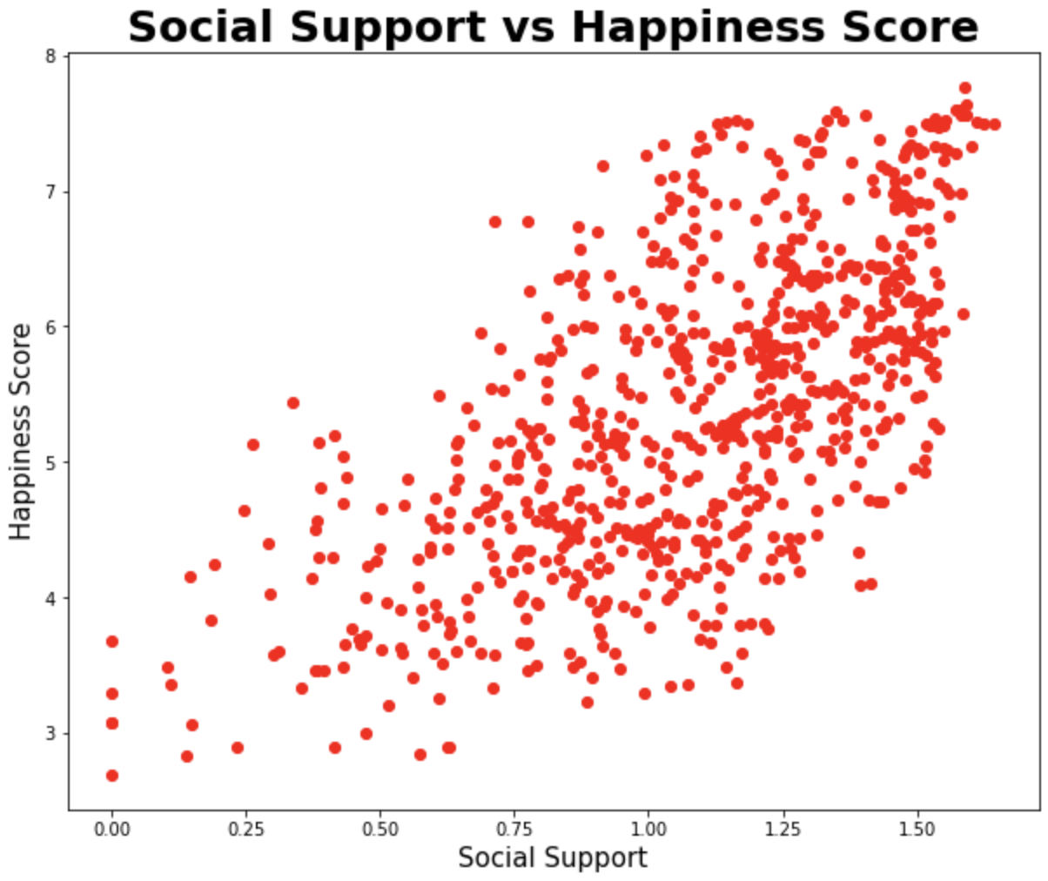
Social Support vs Happiness Score
Correlation
Coefficient: 0.649

Slide 20
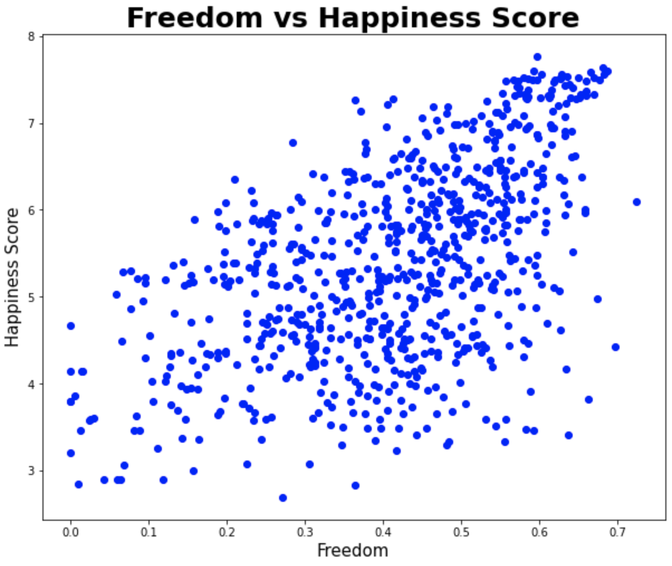
Freedom vs Happiness Score
Correlation
Coefficient: 0.551

Slide 21
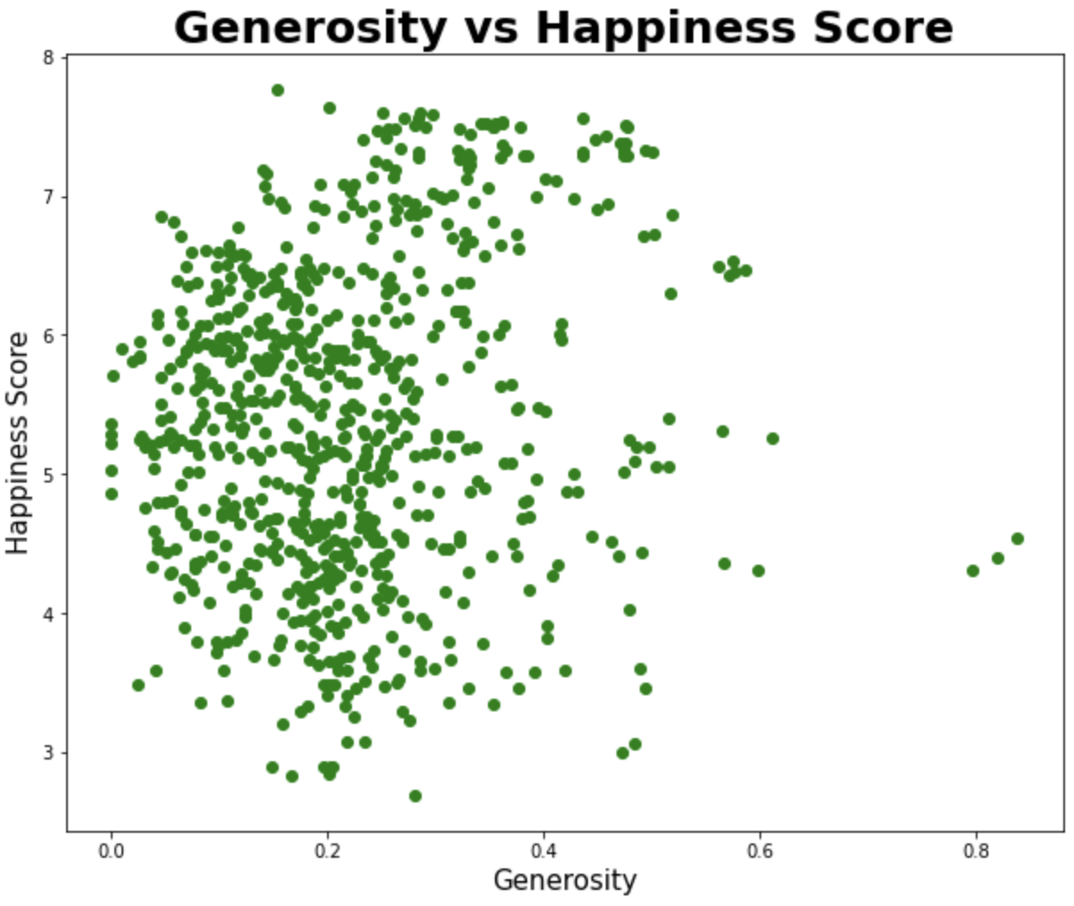
Generosity vs Happiness Score
Correlation
Coefficient: 0.138

Slide 22

Features contributing to happiness

Slide 23

If you are the president of a country, what would you do to make citizens happier?
Acero

Slide 24
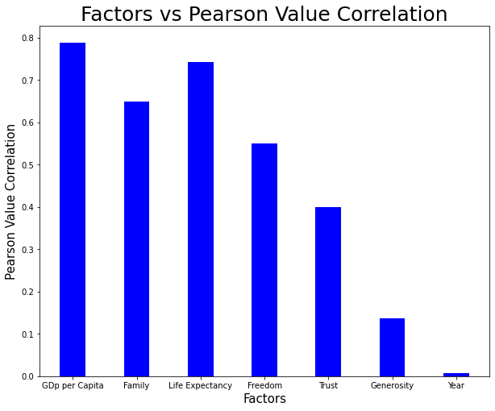
Policies:
Work on the most correlated features
1) GDP per Capita:
Invest in industries (especially those with exports)
Policies that increase consumption
2) Life Expectancy
Better health infrastructure
HealthCare

Slide 25

Modeling Data and Predicting Happiness Score and Ranks

Slide 26

Splitting into Training and Testing Data
Training
Data from 2015 –2018
Testing
Data from 2019
Iman Ali

Slide 27

Multiple Linear Regression Model 1 by Iman Ali
Uses two or more independent variables to predict the outcome of a dependent variable.
Independent Variables:
GDP per Capita, Life Expectancy, Family/Social Support & Freedom
Independent Variable:
Happiness Score

Slide 28
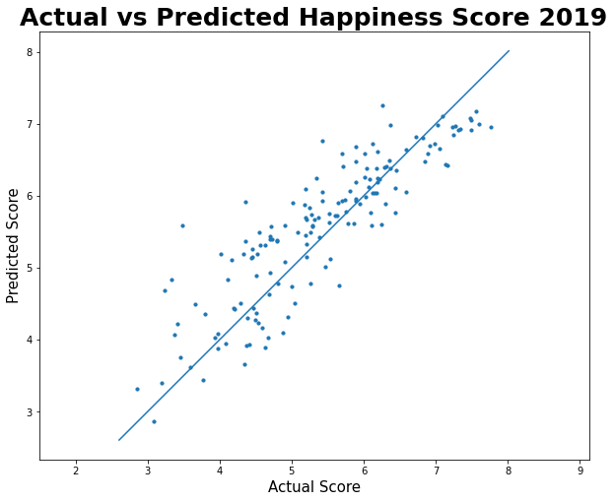
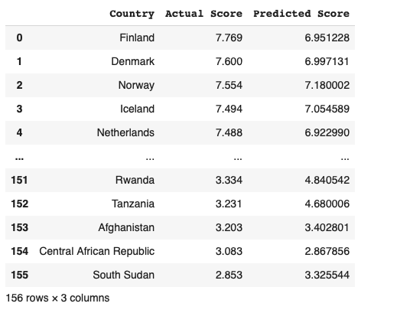
Predictions (Happiness Score)
After training from the learning regression model, we predicted the Happiness Score values for the year 2019
Iman Ali

Slide 29
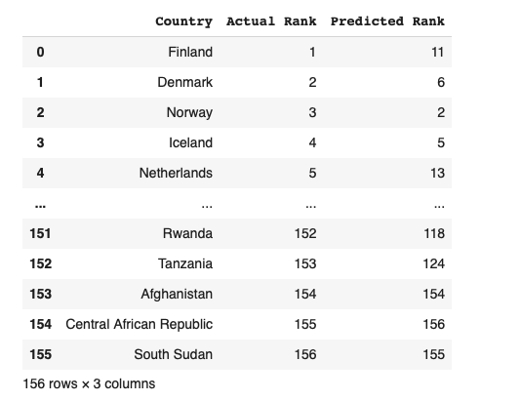
Predictions (Happiness Rank)
Using the 'Happiness Score' predictions from multiple linear regression, we ranked the countries in increasing order of happiness to get the 'Happiness Rank'
Iman Ali

Slide 30
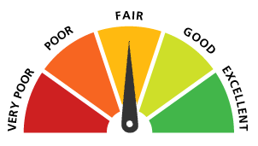
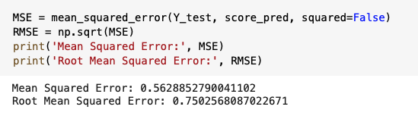
Performance of Model 1
Score = 0.743
Meaning 74% of the predictions were correct
Mean Squared Error & Root Mean Squared Error
MSE = 0.56
RMSE = 0.75
According to the sklearn library:
Mean squared error return: the best value is 0.0
Lower values of MSE indicate better fit.
Since we have quite a low value of 0.56 (close to zero) that means our model did a good job at predicting happiness scores and therefore accurate ranks
Iman Ali

Slide 31

K Nearest Neighbor Regression Model 2 by Rahul Raja
Uses k neighbors for each datapoint in order to predict the output

Slide 32

Finding K value
GridSearchCV helped find the best k-value with the training data
The best k-value was calculated to be 6

Slide 33
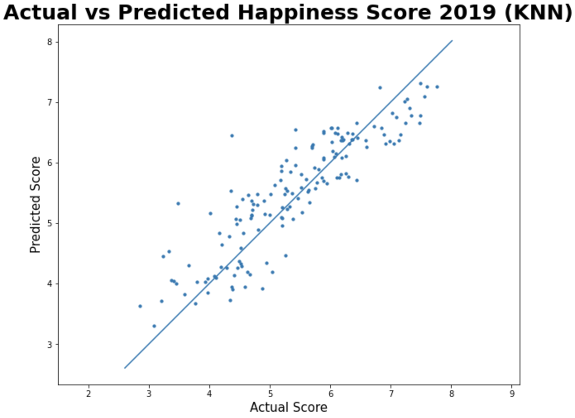
Predictions
Knn model was trained with 2015-2018 data, and tested with 2019 data, while trying to predict the happiness score for each country.

Slide 34
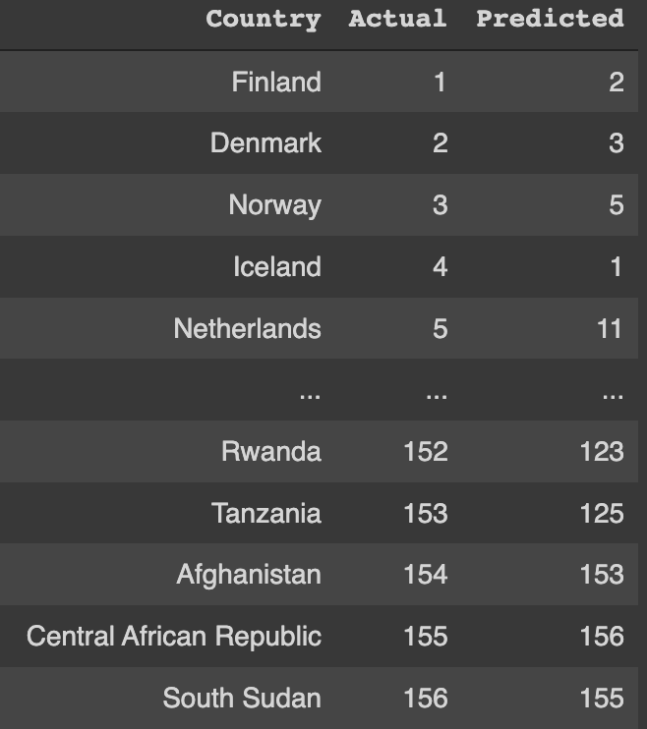
Ranking Prediction
After gathering the new happiness scores, I sorted the countries based on the new results.

Slide 35

Performance
Overall, it had an accuracy rate of 77.30%

Slide 36


Random Forest Regression
Model 3 by Acero

Slide 37
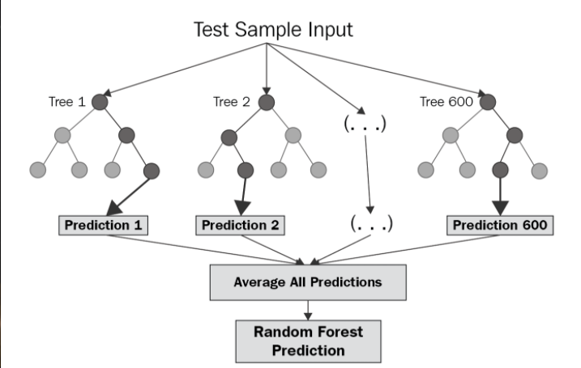
Random Forest
Randomly picks k data points from the training set
Decision tree based on the chosen points
Pass how many trees you want to make

Slide 38
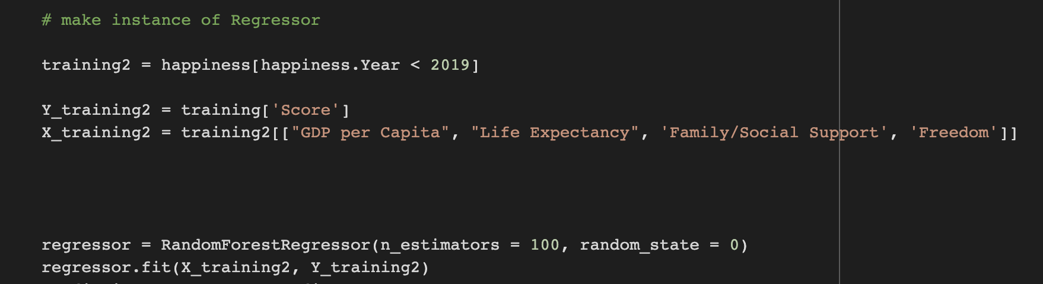
Procedure
Separate training and Testing data
We want to predict Happiness Score, so set that to Y, the highly correlated features will be X
Create 100 trees in model

Slide 39

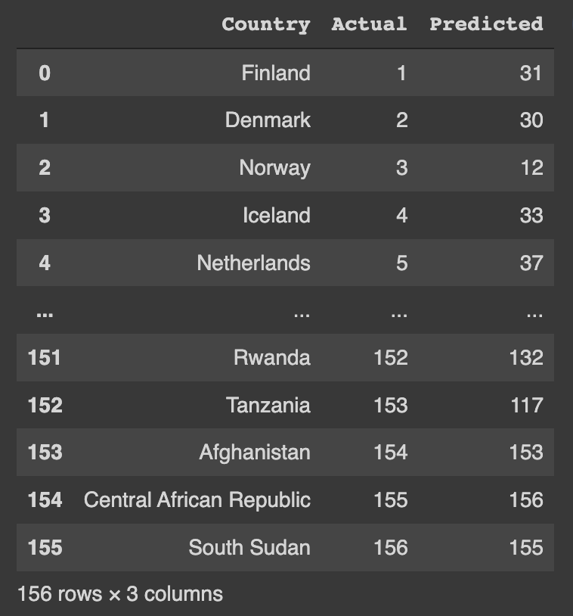
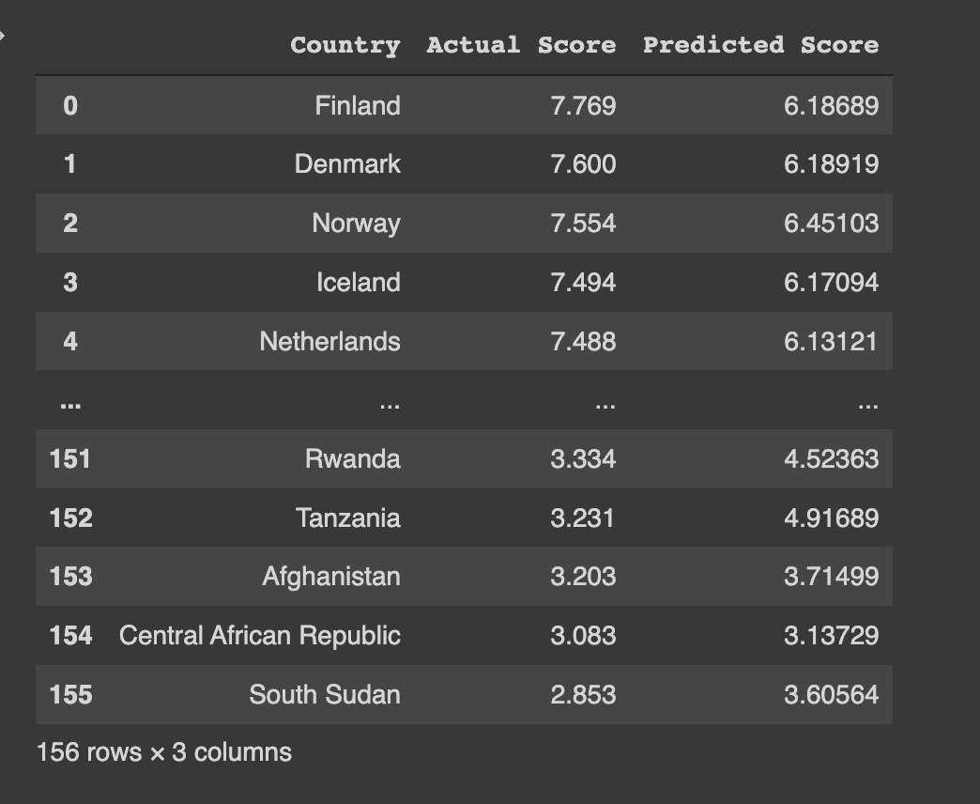
How did it do?

Slide 40

Performance Stats
Accuracy of 61.67%, the worst of the three models
Root mean squared error of 82.9%

Slide 41

Thank you!

